Slide 1



Music Genre Classification Using Machine Learning
- Presented by: Lokesh Bhatta (NP000526)
BSc. (Hons) Information Technology
- Supervised by: Mr. Jyotir Moy Chatterjee
- Second Marker: Ms. Saya Joshi

Slide 2


Presentation Contents
Introduction to the Project
Literature review and Similar System Review
Technologies Used
Machine Learning Algorithms Used to Train and Test the Model
Libraries Used in the Project
System Development Methodology Used
Use-Case Diagram & System-Flow Diagram
User Interface
Results
Conclusion

Slide 3


Introduction to the Project
Aim
The project aims to create an accurate system for categorizing music genres using a machine learning algorithm which involves analyzing music features and building a system that can classify songs into different genres, which contributes to the music industry and music professionals for improving music recommendation systems and personalized playlist, music production and storage.
Objectives
To develop a web-based application that allows, music professionals and listeners to classify songs based on their genre using Machine Learning Algorithms.
To extract relevant features from the music dataset for use in machine learning algorithms, and classify music genres.
To develop a system that can generate a genre probability distribution chart and Mel- spectrogram diagram for the classified music file.
To demonstrate the usability of the developed music genre classification system by implementing it in a web application helping in music production or music recommendation.

Slide 4
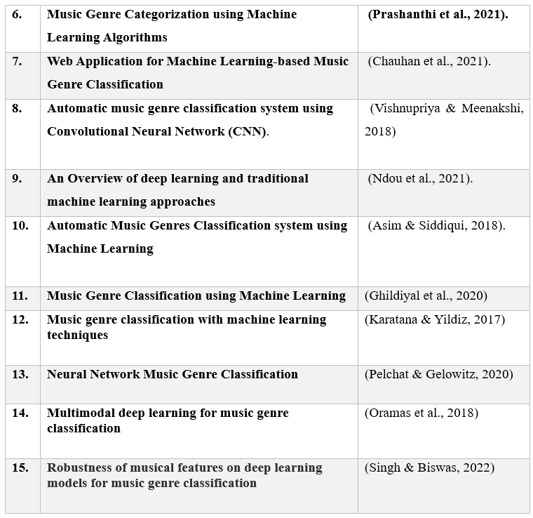
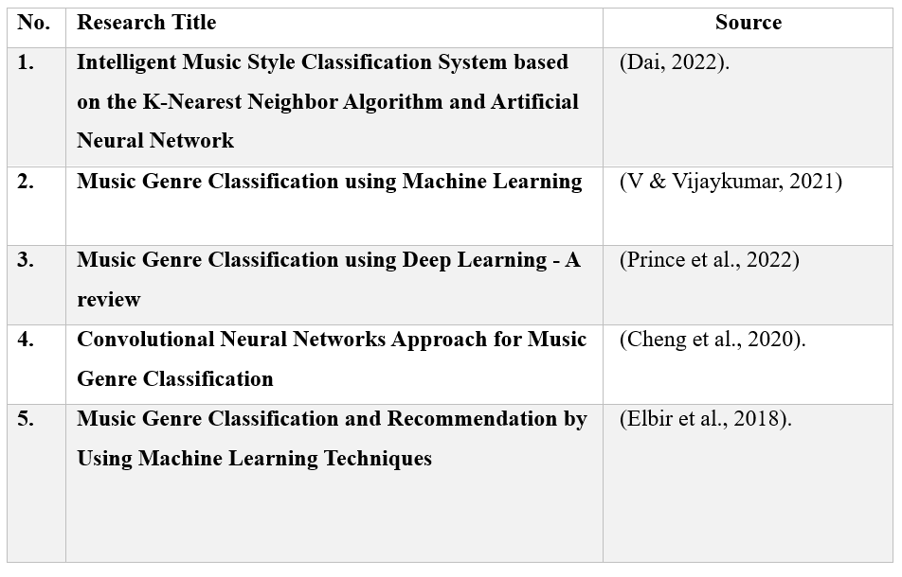
Literature Review

Slide 5
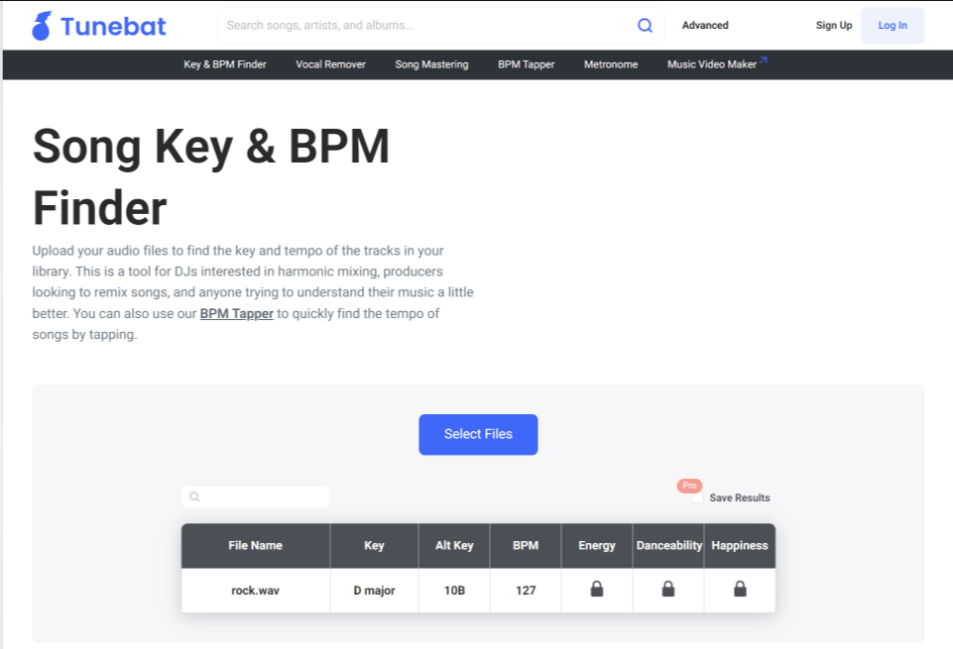
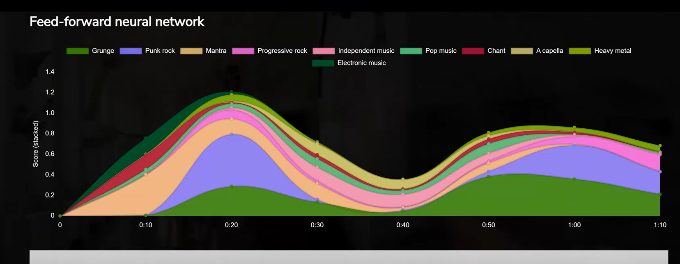
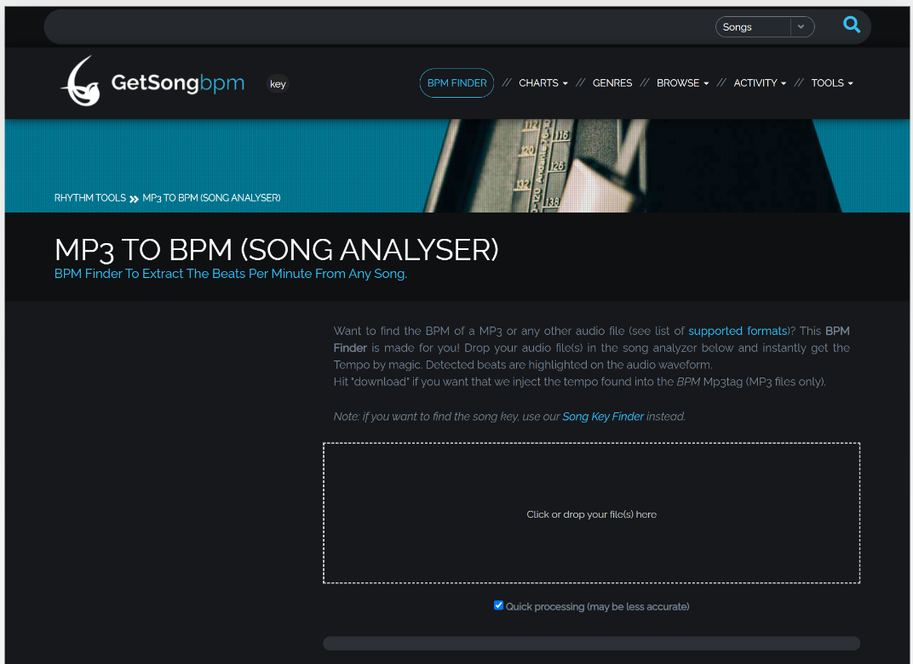
Similar System Review

Slide 6


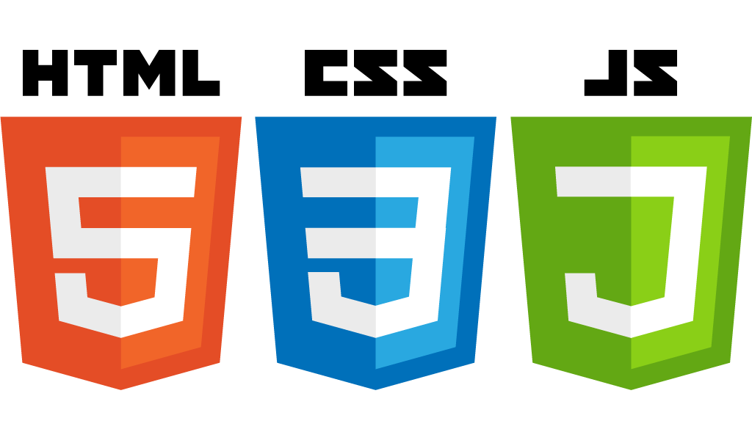



Technologies Used

Slide 7
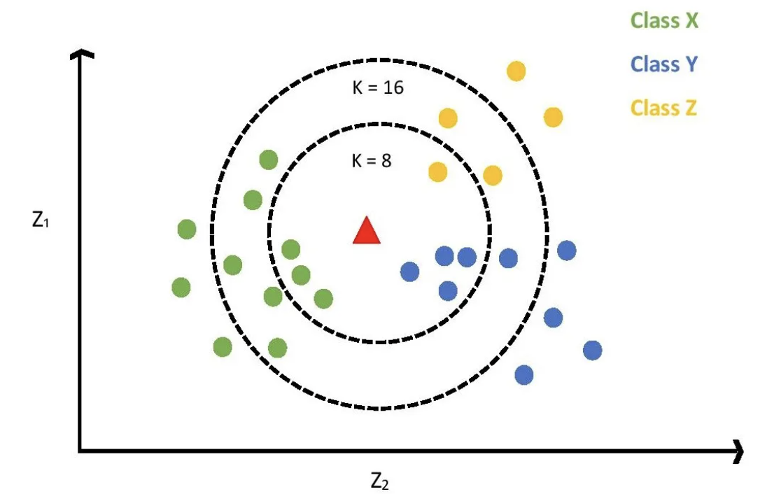
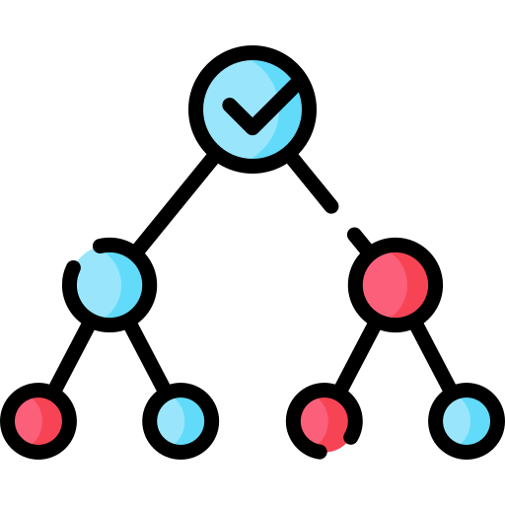
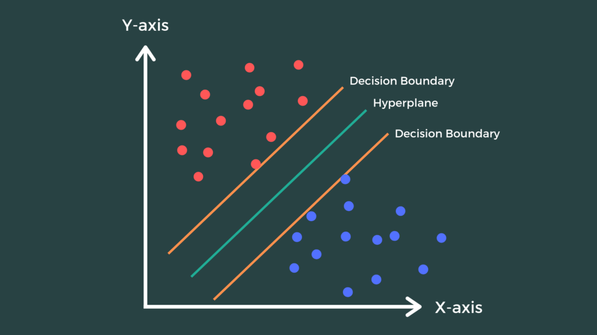
ML Algorithms Used to Train and Test Dataset
K-Nearest Neighbor (KNN)
Decision Tree
Support Vector Machine

Slide 8

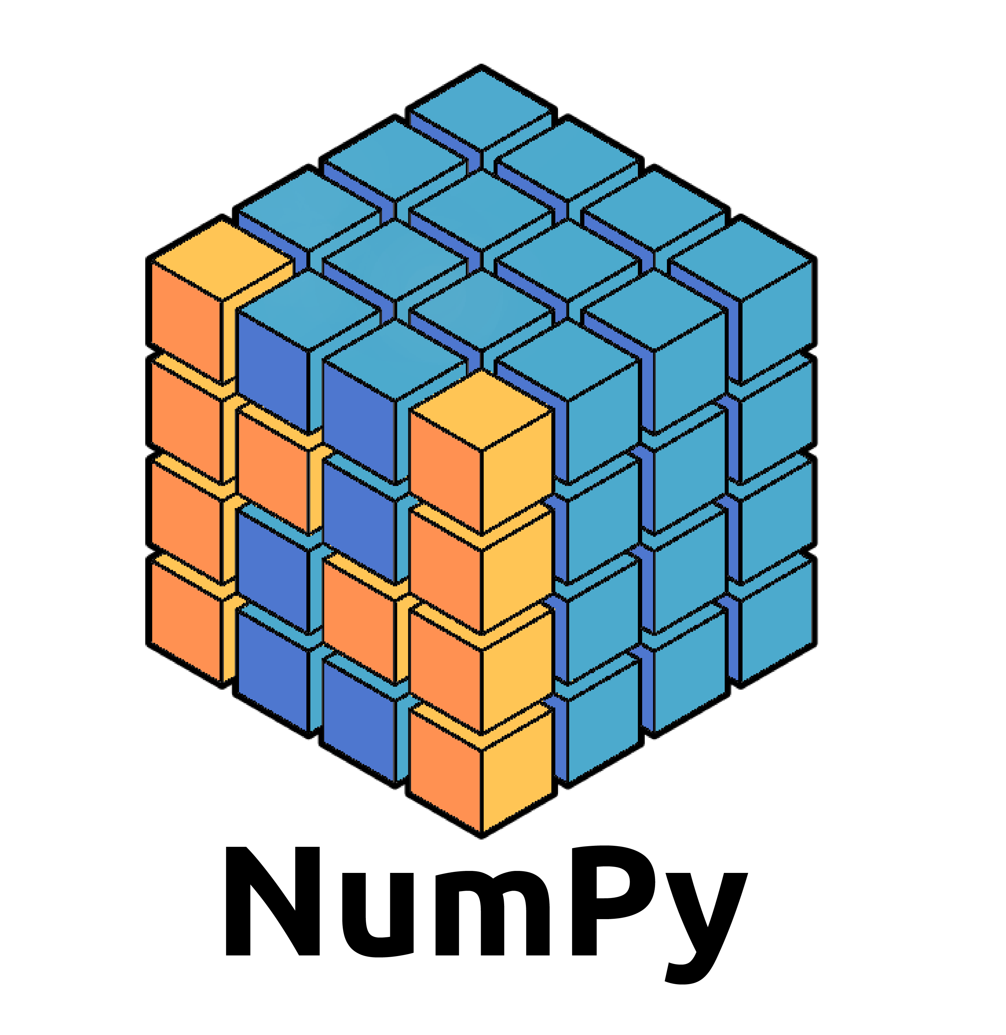

Python Libraries Used in the Project
Pandas is a Python library used for working with data sets. It has functions for analyzing, cleaning, exploring, and manipulating data.
NumPy is a fundamental package for numerical computations in Python. It provides support for arrays, matrices, and a variety of mathematical functions.
Librosa is a library specifically designed for audio and music analysis. It provides tools for audio feature extraction, time-domain and frequency-domain analysis, and more.
Notes:
Functions of Pandas:
DataFrame: A 2D table-like data structure that can hold various data types. It is similar to a spreadsheet or SQL table.
Series: A 1D labeled array capable of holding any data type.
Data Cleaning and Transformation: Pandas offers functions for data cleaning, transforming, merging, and reshaping datasets.
Data I/O: Reading and writing data to various formats like CSV, Excel, SQL databases, and more.
Functions of NumPy:
Arrays: N-dimensional arrays that can hold elements of the same data type.
Mathematical Functions: NumPy includes a wide range of mathematical functions for linear algebra, Fourier transforms, random number generation, and more.
Array Indexing and Slicing: Efficient indexing and slicing of arrays.
Functions of Librosa
Audio Loading: Load audio files in various formats and extract audio data.
Spectral Analysis: Compute spectrograms, mel-frequency cepstral coefficients (MFCCs), chromagrams, and other spectral features.
Beat and Tempo Analysis: Estimate beat and tempo information from audio signals.
Time-Domain Analysis: Calculate zero-crossing rate, root mean square energy, etc.

Slide 9
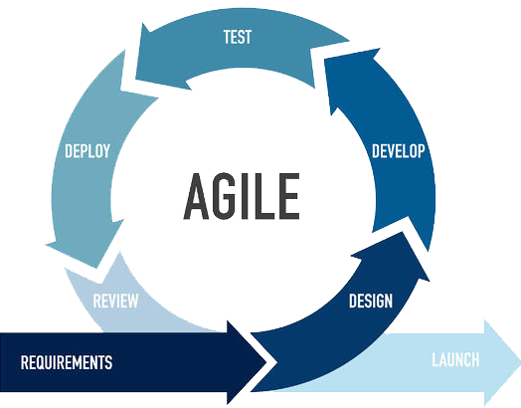
System Development Methodology Used

Slide 10
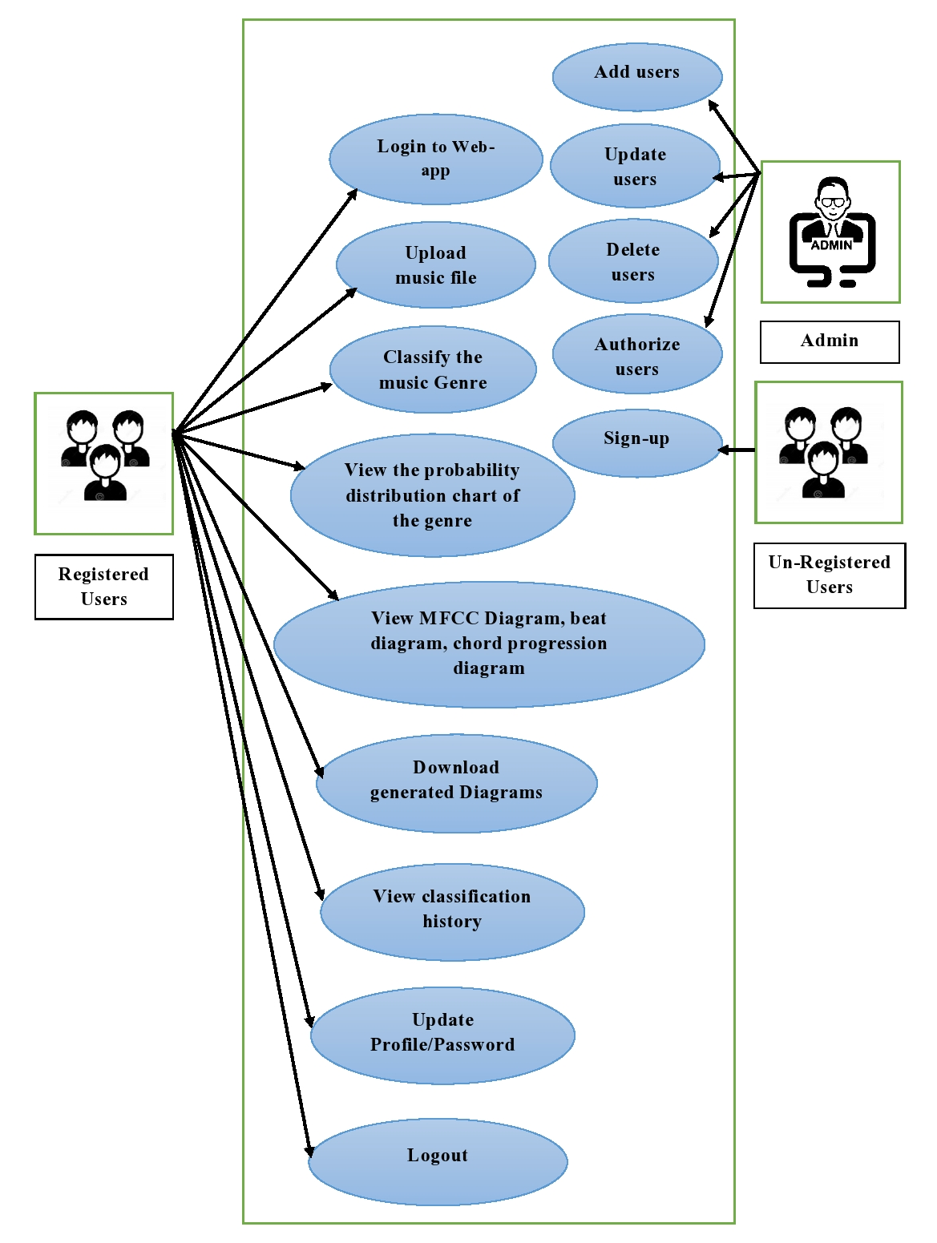
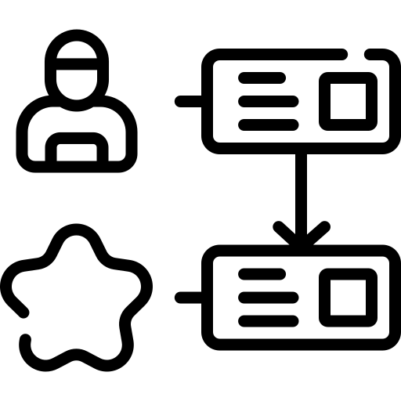
Use-Case Diagram

Slide 11
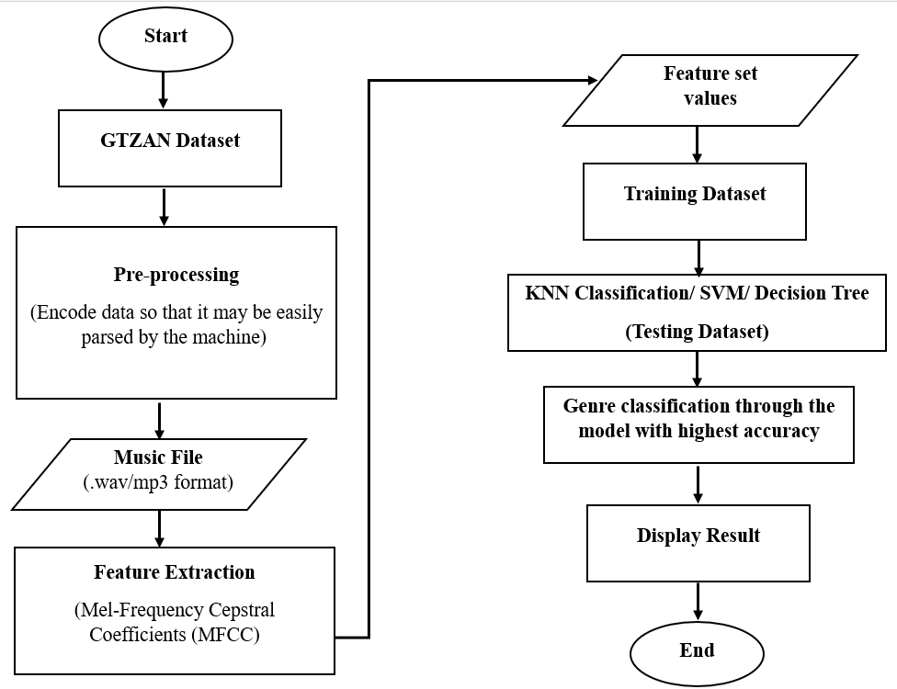

System Flow Diagram

Slide 12
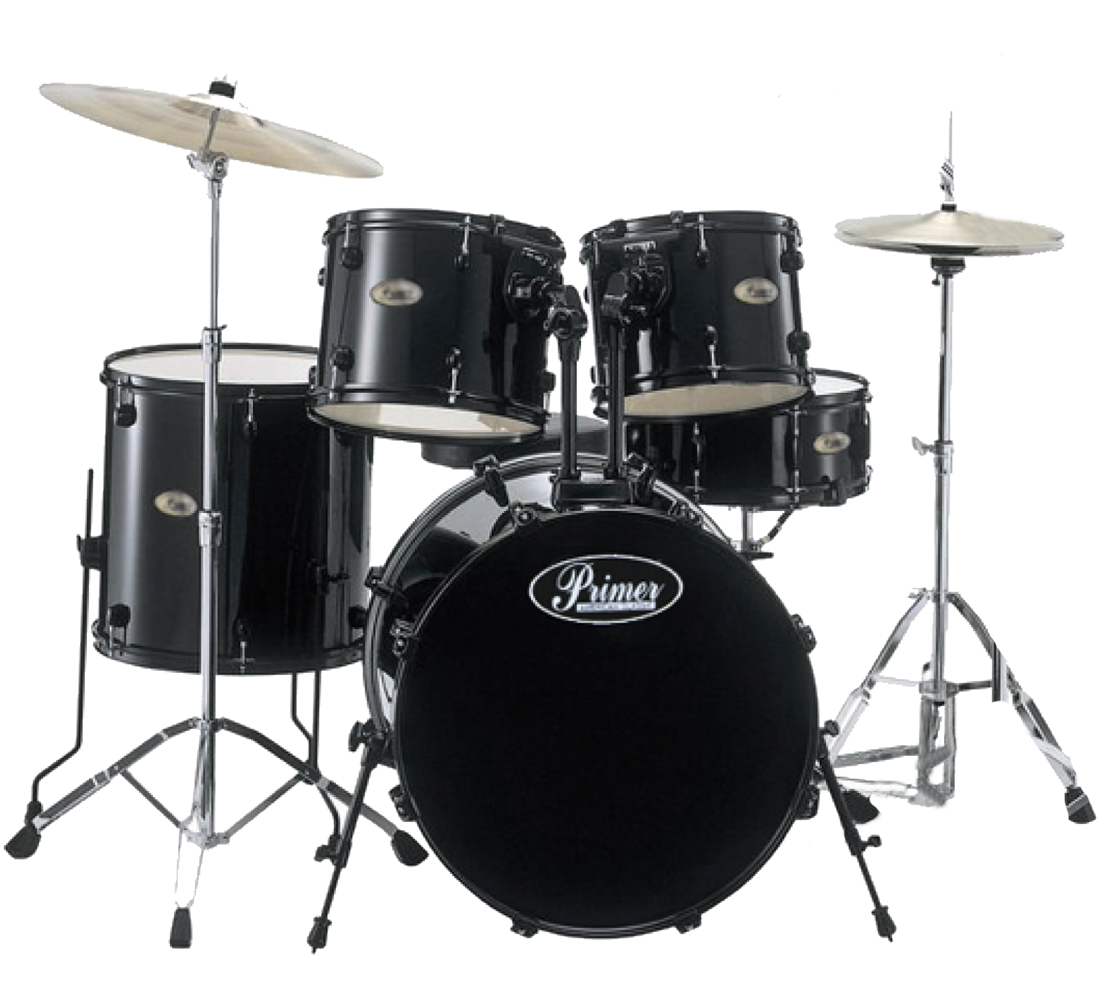
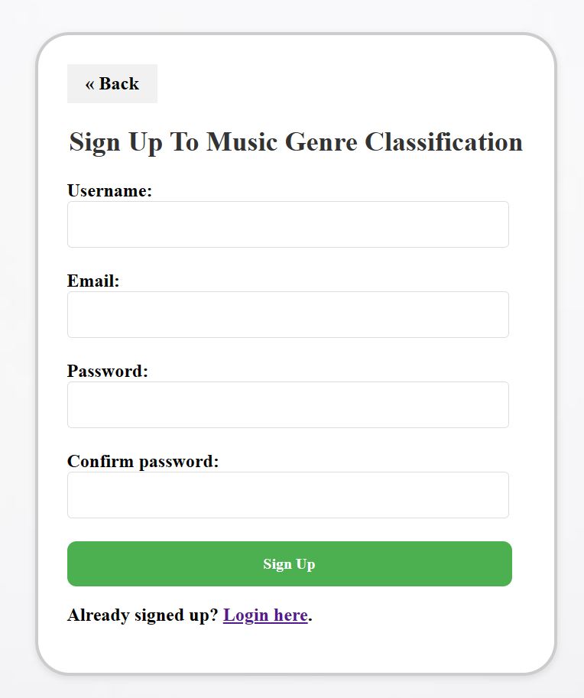
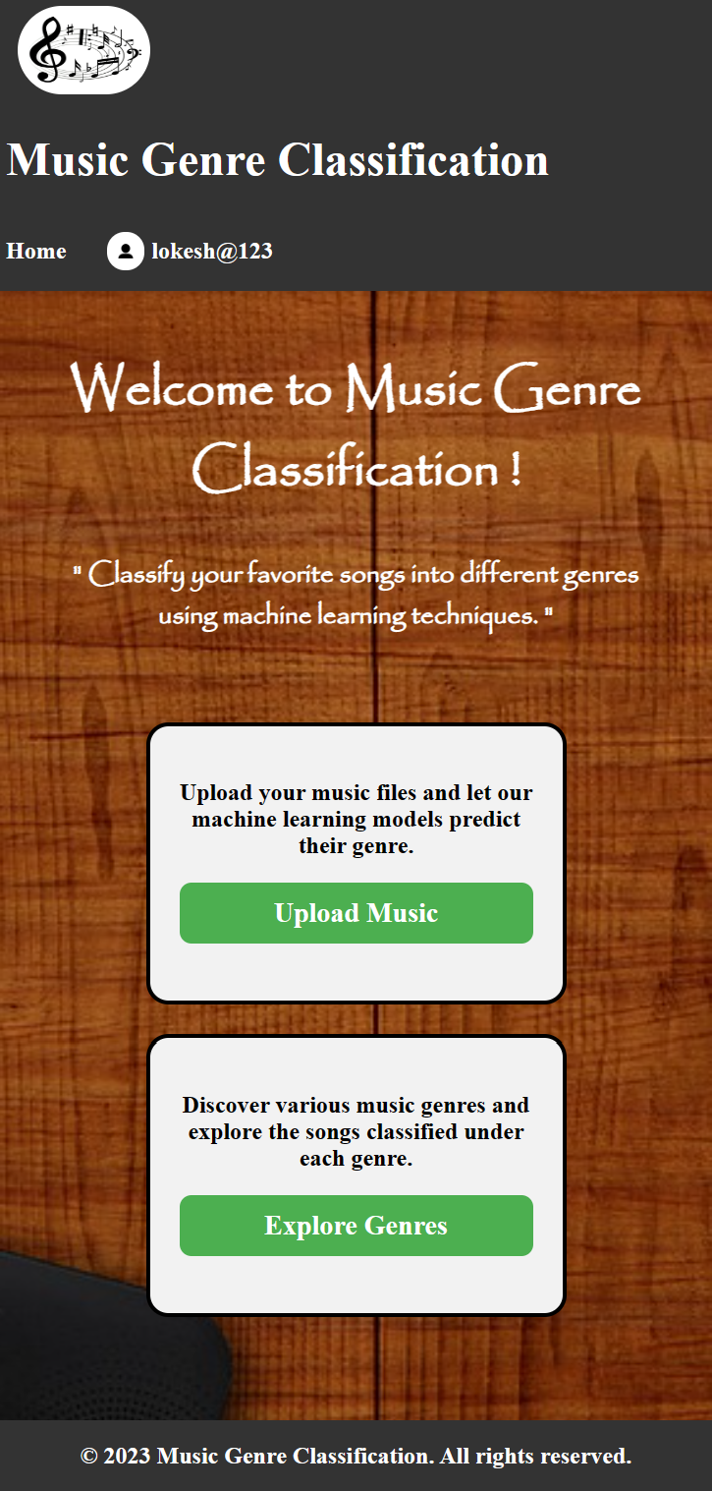
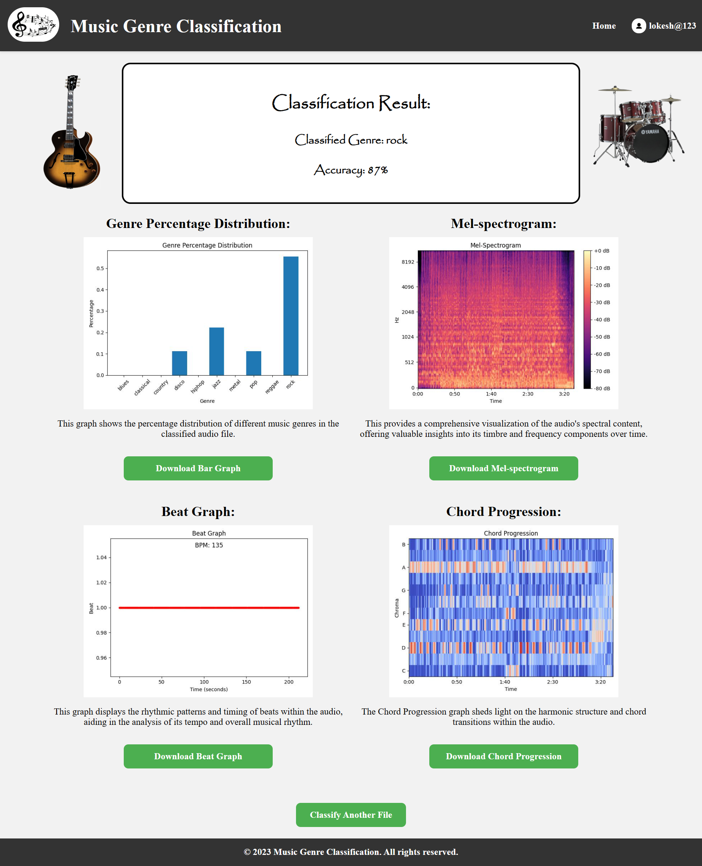
User Interface

Slide 13
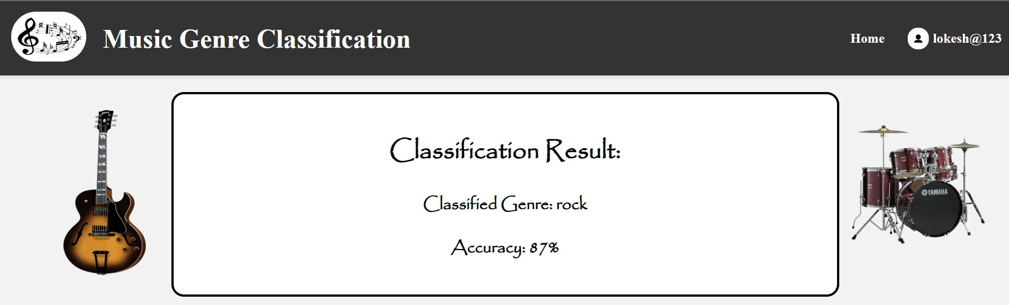
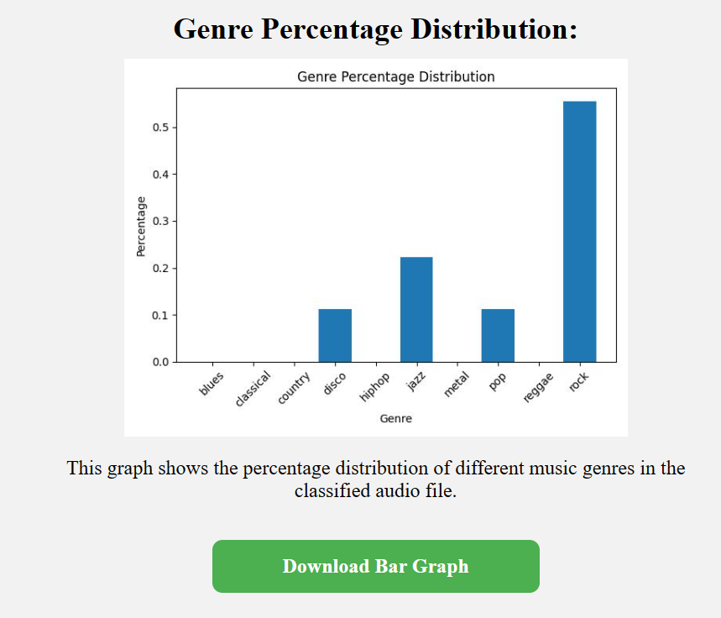
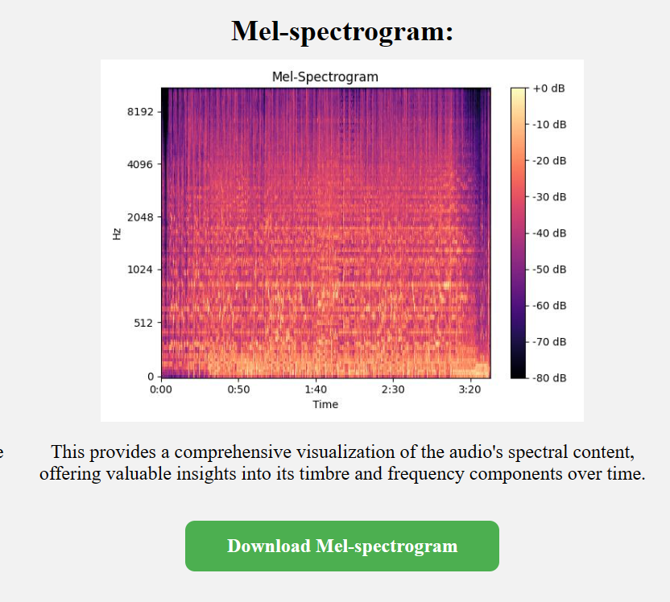

Slide 14
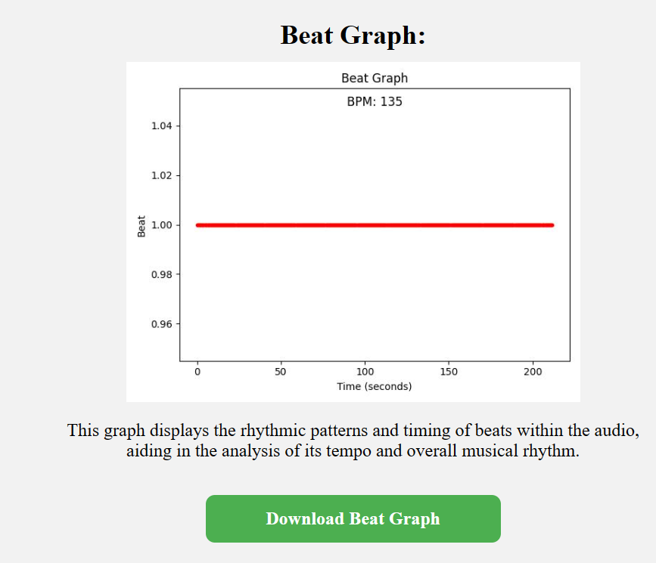
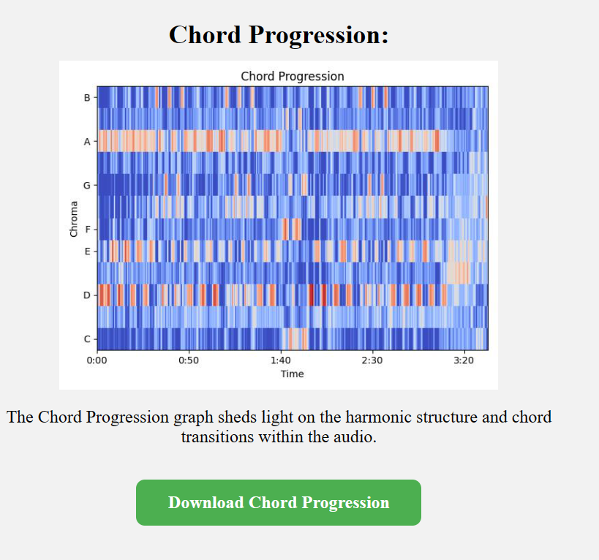

Slide 15
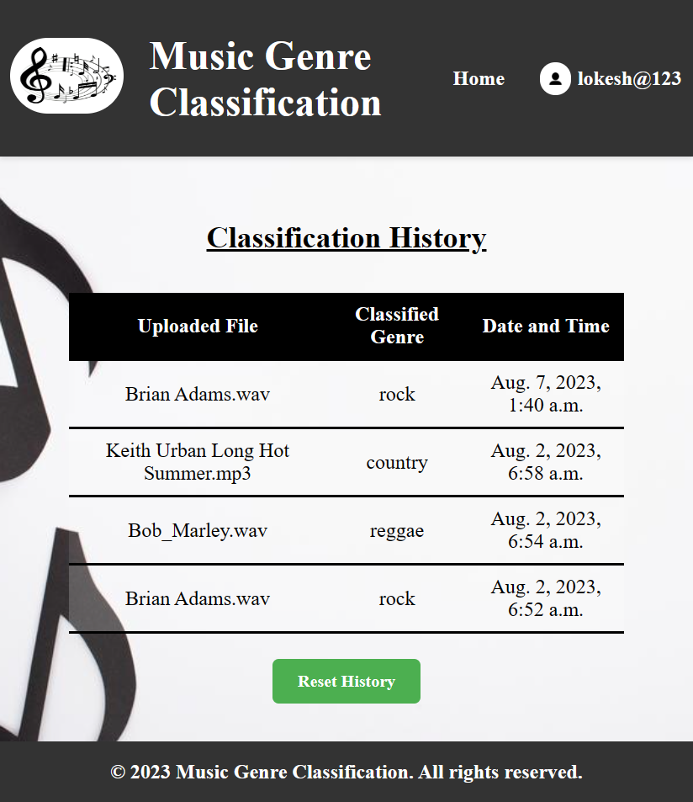
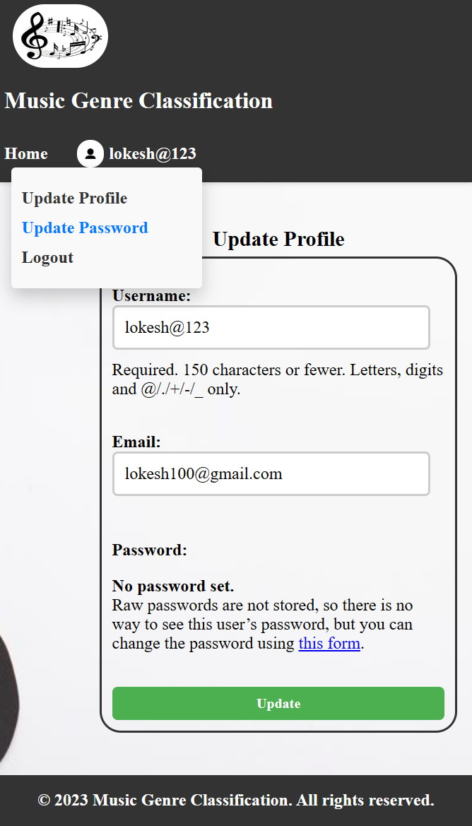
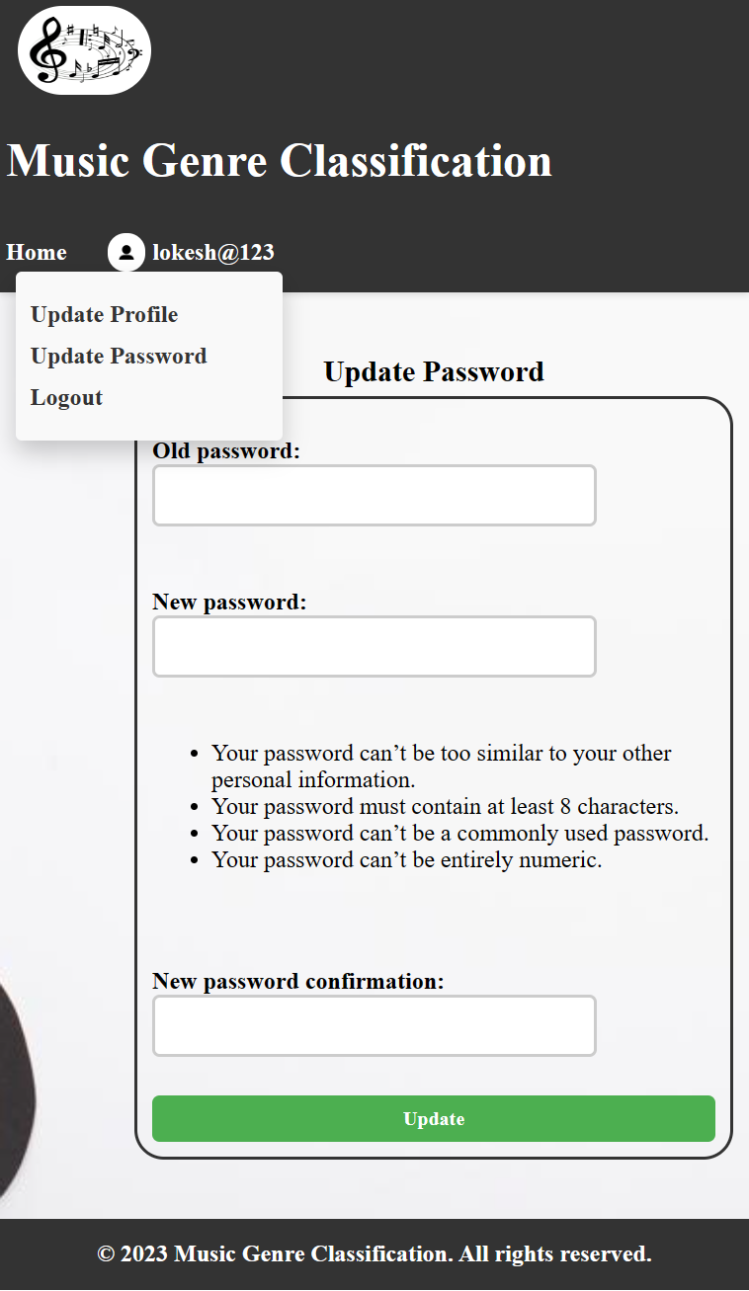

Slide 16
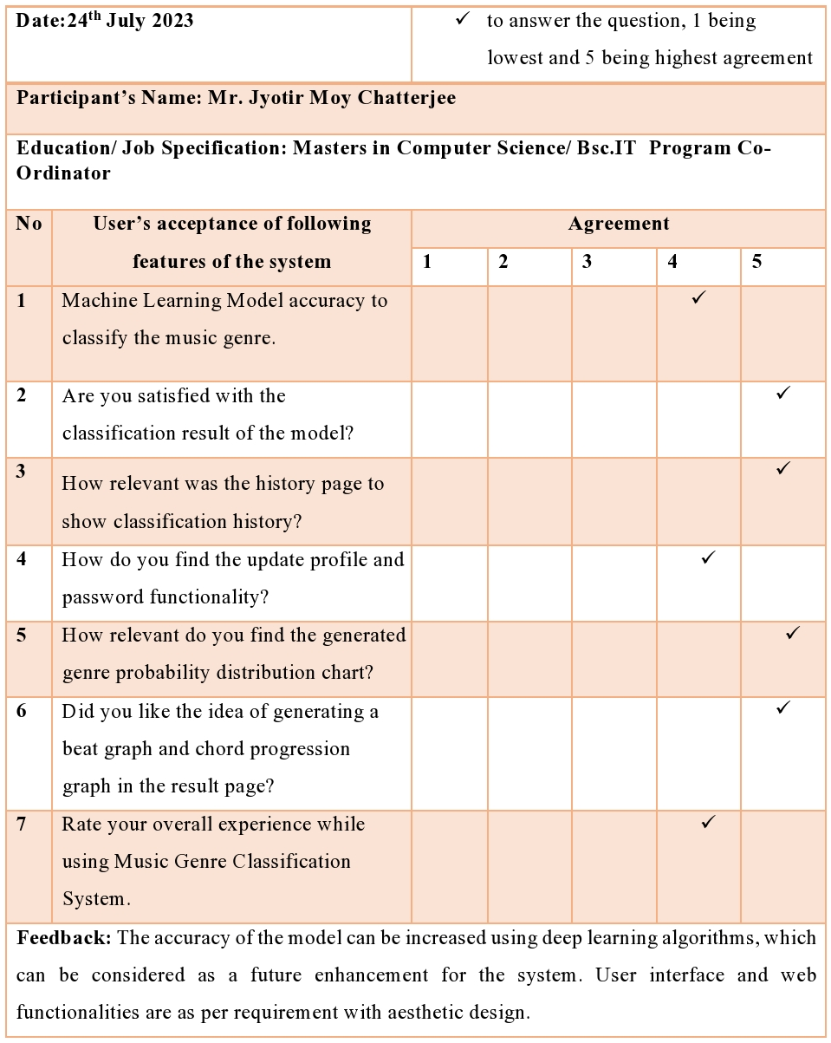
System Testing
Unit Testing
Integration testing
Usability testing
User-acceptance testing

Slide 17
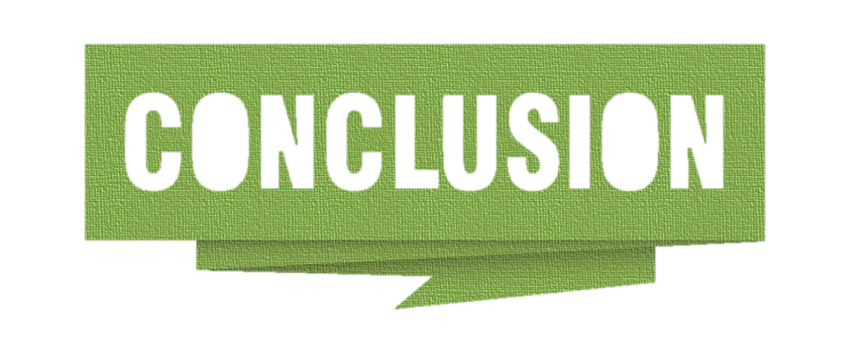

Slide 18


Slide 19

Project Demonstration
Notes:
Class Definitions: - Throughout the code, you're interacting with Django models, forms, and views. These classes are defined using object-oriented concepts. For example, the `SignUpForm`, `LoginForm`, `ProfileUpdateForm`, and `ClassificationHistory` are classes defined using Django's class-based form and model definitions. (forms.py & models.py)
2. Inheritance:
- Django forms and views often use inheritance to extend the functionality of built-in classes. For instance, you're using `auth_views.PasswordResetView` and its related classes for password reset functionality. These classes inherit and extend the behavior of Django's default authentication views. 3. Encapsulation and Abstraction:
- Django models encapsulate database tables and fields, providing an abstract representation of the database structure. 4. Modularity and Reusability:
- Django promotes modularity and reusability through its class-based views, forms, and models. These classes can be reused in different parts of the application to achieve consistency and minimize code duplication.
5. Dependency Injection:
- In the views, you're injecting dependencies such as forms and models into functions. For example, the `upload` function expects the `music_file` form field and uses the machine learning model to perform classification.

